Slide 1
HOUSING FOR DAIRY CATTLE a)Selection of site for Dairy Farm
1. Topography and drainage
2. Soil type
3. Exposure to the sun and protection from wind
4. Accessibility
5. Durability and attractiveness
6. Water supply
7. Surroundings
8. Labour
9. Marketing
10. Electricity
11. Facilities, labour, food

Slide 2
Floor space requirements for cattle and buffalo shed
Type of animal | Covered area | Open area | No.of pens
Buffaloes | 4.0m2 | 8.0m2 | 50/pen
Cattle | 3.5m2 | 7.0m2 | 50/pen
Calves | 12.0m2 | 12.0m2 | 1/pen
Feeding and Watering space requirements
Breed | Feeding space | Watering space
Buffaloes | 75cm/animal | 75cm/animal
Cattle | 75cm/animal | 75cm/animal

Slide 3
Main building in dairy farm milk Animal Shed
Milking barn or parlour
Down calver shed / calving pen
Calf pen
Young stock or heifer shed
Dry animal shed
Bull shed
Isolation shed
Quarantine shed

Slide 4
milk Animal Shed
Essentials of Feeding passage
Feeding passage
Manger
Standing space
Gutter or drainage channel
Milking passage

Slide 5
Single row system
Double row system

Slide 6
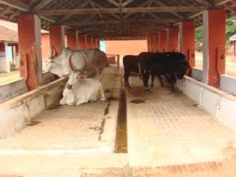
Tail to Tail System
Advantages

Slide 7
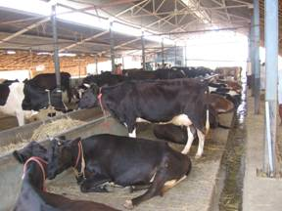
Face to face system
Advantages and disadvantages

Slide 8
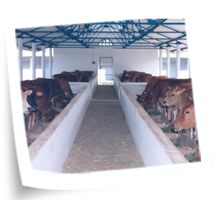

Slide 9
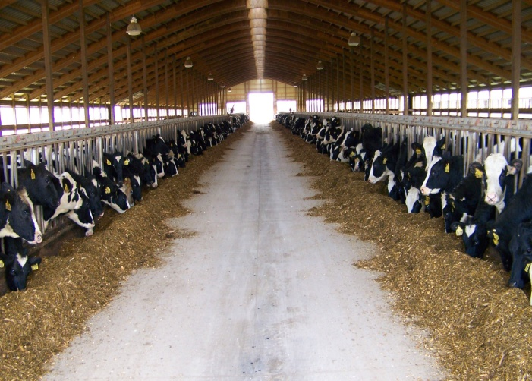

Slide 10
Milking barn or parlour:
Dimensions of Milking barn :
Length of standing space : 1.5 – 1.7 m
Width of standing space : 1.05 – 1.2m (80% of length, of standing space)
Width of central passage : 1.5 – 1.8 m
Width of feed alley : 0.75 m
Width of gutter : 0.30 m
Overhang : 0.75 m
Down calver shed/ calving pen:

Slide 11
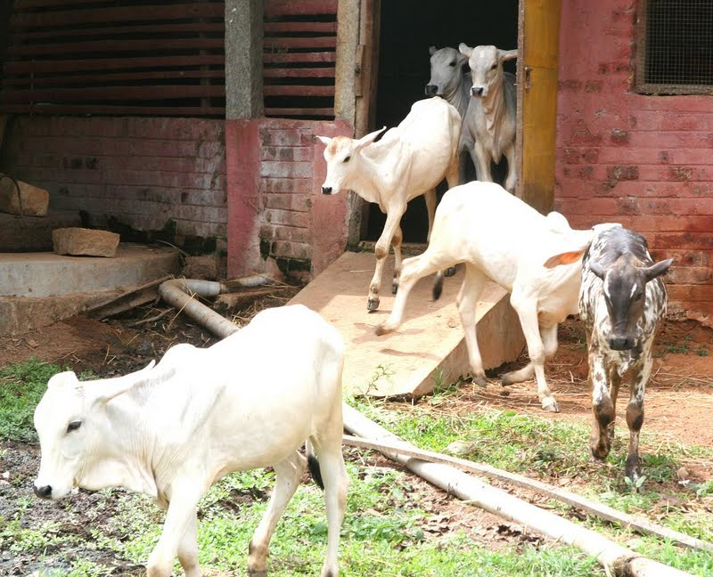
Calf pen

Slide 12
Young stock/ heifer shed:
Dry animal shed:
Bull shed :
Isolation shed:
Quarantine shed:
Accessory buildings
a. Store room:
b. b. Milk room:
c. Hay or straw shed:

Slide 13
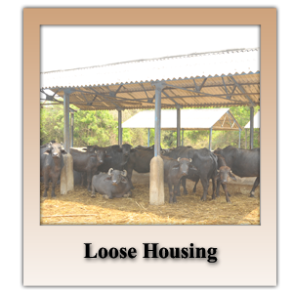

Slide 14
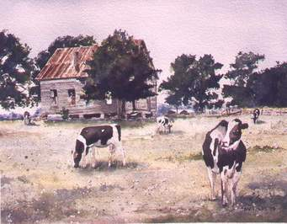

Slide 15
Advantages
Disadvantages b. Conventional Barns or Stanchion Barns

Slide 16
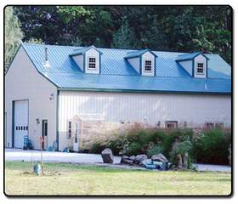

Slide 17
